Slide 1


E-Commerce Product Delivery Prediction
By : Oankar Santosh Ghorpade
CONFIDENTIAL: The information in this document belongs to Boston Institute of Analytics LLC. Any unauthorized sharing of this material is prohibited and subject to legal action under breach of IP and confidentiality clauses.

Slide 2
Objective Of the Project
The objective of doing the e-commerce project is how to improve the efficiency of product delivery timeliness and to improve the customer satisfaction using 4 different supervised machine learning models.

Slide 3
Approach
This slide will give a brief overview of the approach I took for the project
Followed the machine learning process flow
Used EDA for Understanding relationship of data
Used Hyperparameter tuning
Used Classification Report to find the accuracy of the all the 4 model for comparison

Slide 4
Machine Learning Process Flow
Feature Engineering
Model Fitting
Understanding the Data
Data Encoding
Model Predict
Loading all the required libraries
Data Preprocessing
Scaling
Confusion Matrix
EDA
Train-Test-Split
Classification Report

Slide 5
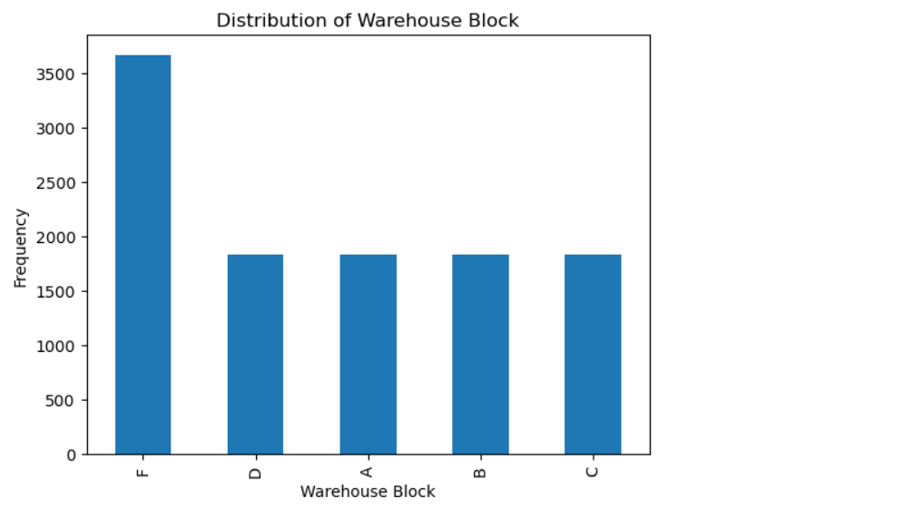
EDA(Exploratory Data Analysis)
Here Are Few Screen Short Of the EDA I performed
Univariate EDA Screen Shot

Slide 6
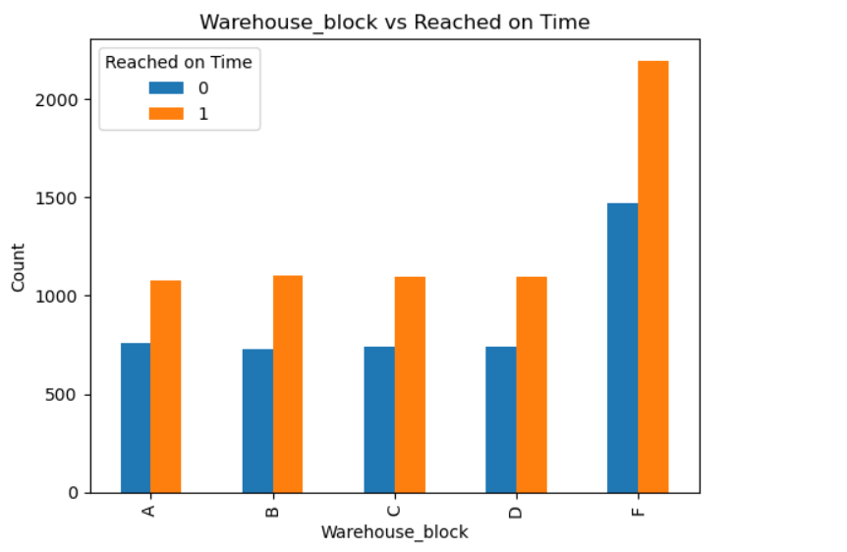
EDA(Exploratory Data Analysis)
2. Bivariate EDA Screenshot

Slide 7
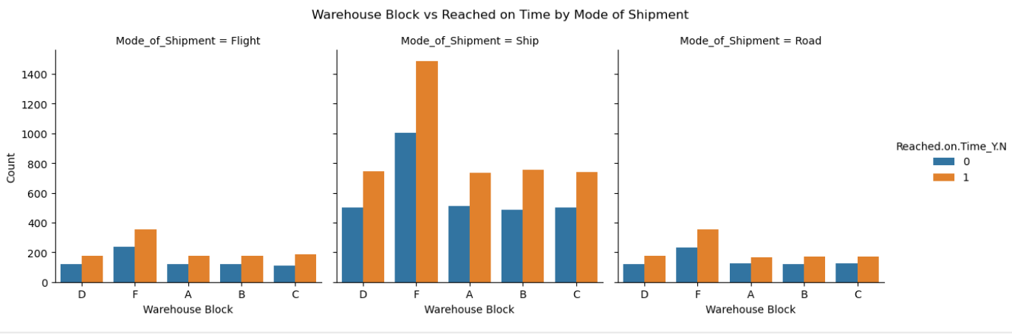
EDA(Exploratory Data Analysis)
3. Multivariate EDA

Slide 8
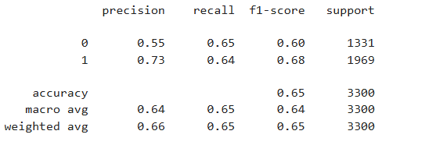
Accuracy Of all 4 Machine Learning MODEL
Here I Put the Screen Shots of the 4 Accuracies of the Machine Learning Models
Logistic Regression Machine Learning Model:

Slide 9
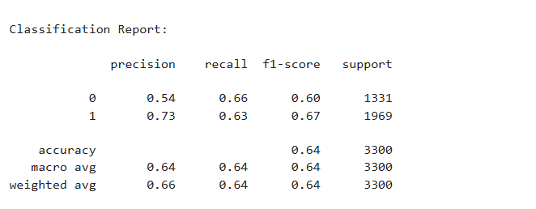
Accuracy Of all 4 Machine Learning MODEL
2.KNN Machine Learning Model

Slide 10
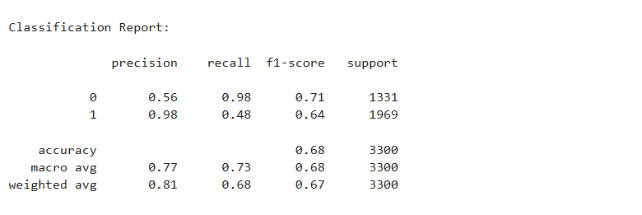
Accuracy Of all 4 Machine Learning MODEL
3. Decision Tree Classifier Machine Learning Model

Slide 11
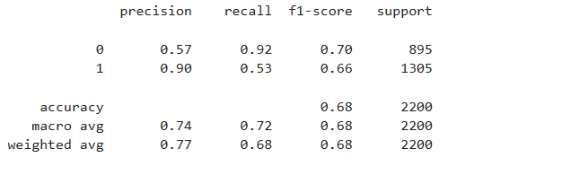
Accuracy Of all 4 Machine Learning MODEL
4. Random Forest Classifier Machine Learning Model:

Slide 12
Deliverable/Outcomes
From the exploratory data analysis to evaluating the performance of four machine learning models, this project helped me understand that product delivery time is influenced by multiple interacting factors such as discounts, product importance, customer ratings, and warehouse block assignments.
Through multivariate EDA, particularly the analysis comparing mode of shipment, warehouse block, and on-time delivery status, we observed that the choice of shipment mode combined with the assigned warehouse block significantly affects whether a product reaches the customer on time.
In addition to shipment mode and warehouse allocation, other factors such as product weight, discount level, and customer interaction metrics also play an important role in delivery performance.
Therefore, to improve delivery efficiency, the company should not rely on a single factor. Instead, it should focus on optimizing key aspects such as shipment mode selection, warehouse assignment, discount strategies, and product prioritization to minimize delivery delays.
Among the machine learning models evaluated, Random Forest achieved an accuracy of approximately 68%. Although the Decision Tree model showed a similar accuracy, Random Forest demonstrated better generalization and reduced bias, making it a more reliable model overall.
An accuracy of 68% is considered reasonable given the absence of real-time logistics data and external factors such as traffic, weather, and operational disruptions. With access to real-time data and further feature enhancement, the model’s performance can be improved in future implementations.

Slide 13
Thank You!
CONFIDENTIAL: The information in this document belongs to Boston Institute of Analytics LLC. Any unauthorized sharing of this material is prohibited and subject to legal action under breach of IP and confidentiality clauses.

